Slide 1

Team 5: DEVCOM Paper Wad Competition
Garrett Armstrong, Savannah Metzler, Jonathan Neal, Finlay Patoto, Katie Swinea, Kevin Ulrich
Notes:
Garrett

Slide 2

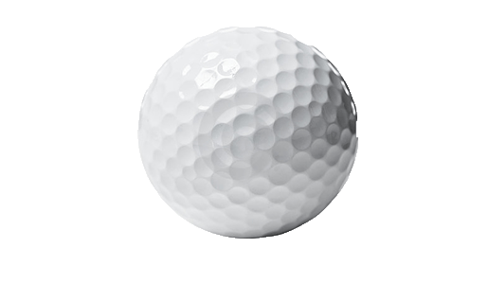
The Problem:
The paper wad has been identified as a new threat by the customer DEVCOM.
The problem that we have been tasked to solve involves intercepting a golf ball, also known as a paper wad, as it falls towards the interceptor on a fishing wire.
DEVCOM wants to use this threat to outreach to STEM students across the United States.
They are hoping to bring this design into classrooms to gain interest in STEM and the Department of Defense.
Notes:
Kevin

Slide 3
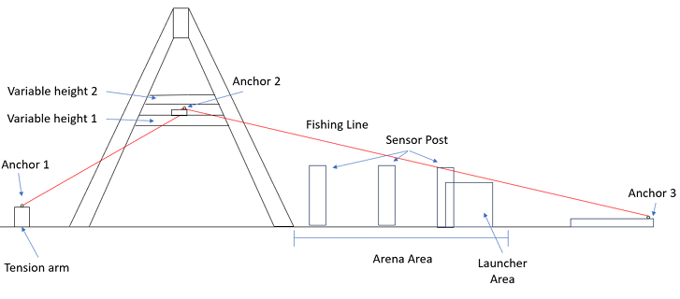
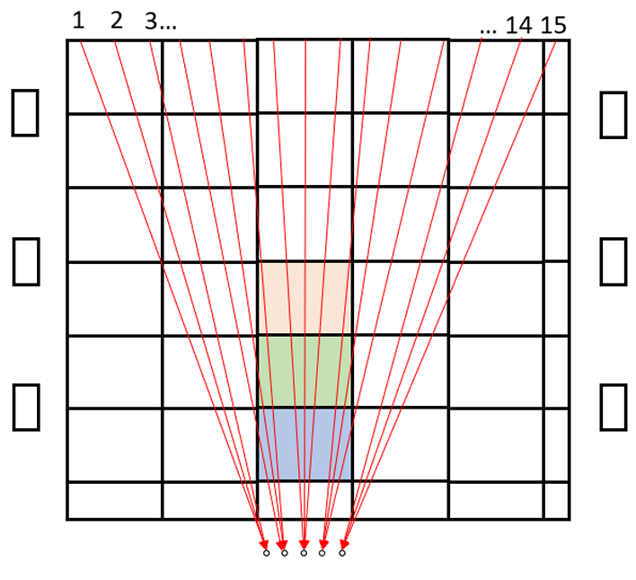
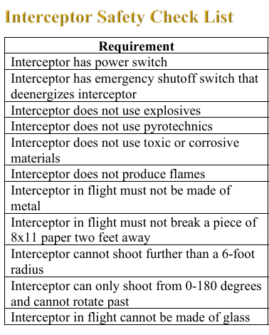
Side View:
Competition Basics
Gameboard:
Launcher Placement
Variable Heights
Sensor Posts
DEVCOM’s Rulebook
Important Rules:
Power Switch
E-Stop
Pause Switch
1ft x 1ft Requirement
6-foot Shooting Requirement
Top View:
Notes:
Fin

Slide 4
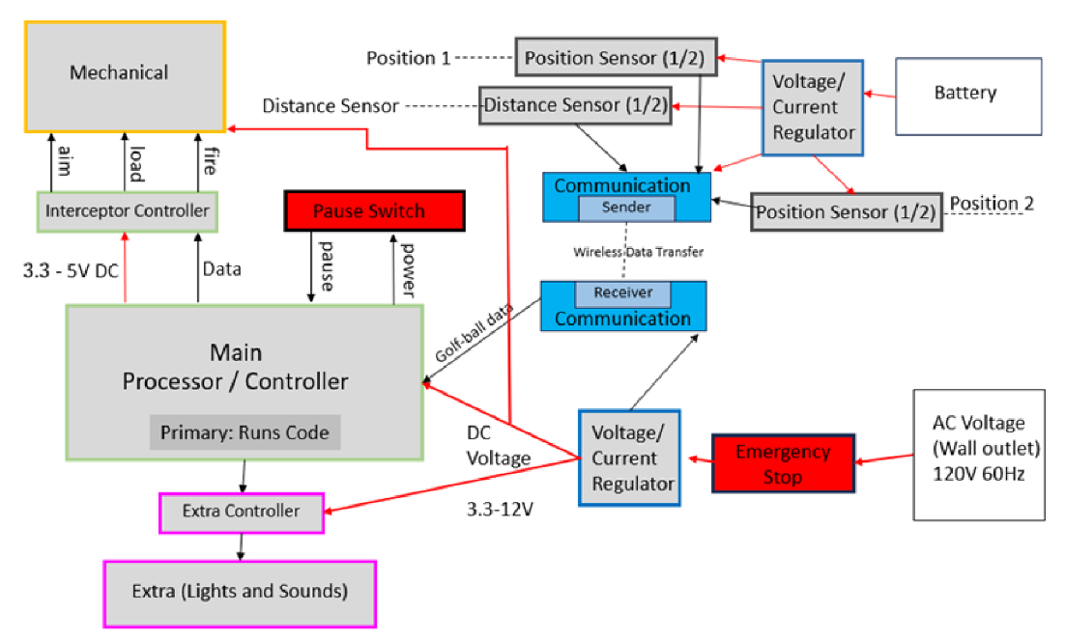
Conceptual Design
Initial design used a time-of-flight sensor, battery power system, and wireless communication.
After conceptual design, the sensor shifted to an Intel RealSense camera.
Camera was mounted on the launcher which eliminated the battery power and wireless communication subsystems.
Notes:
JRN

Slide 5
Standards and Regulations
Power
The IEC 60335-1 regulates the output of a wall outlet to be about 120 V, which limits the voltage that can be used to power the interceptor
Imitation Firearms
USCODE Title 15 state any imitation firearms, like this team’s launcher, must be distinguished using an orange tip.
Wireless communication
The FCC 15.247 standard governs the operable bands of Wi-Fi for free unlicensed use
Notes:
Katie

Slide 6
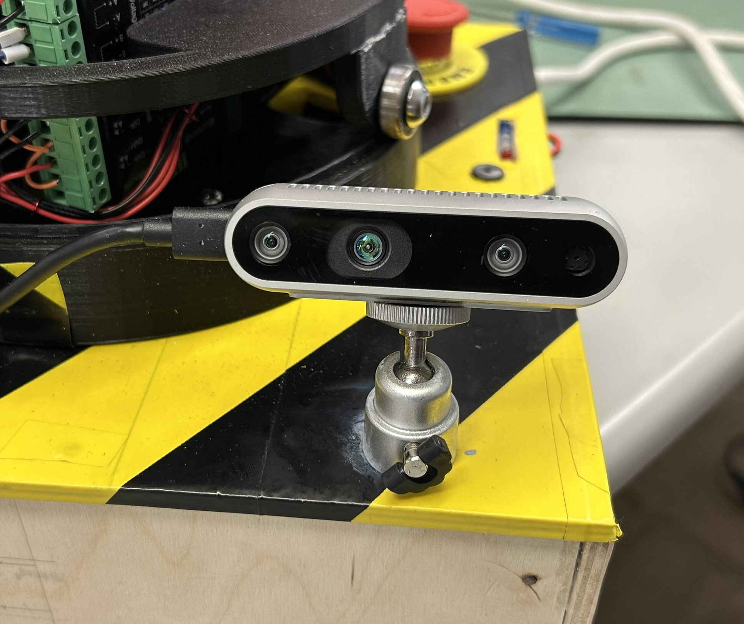

Sensor Subsystem
Intel RealSense D435 depth camera
Uses IR based distance measuring
Used color mask to used edge detection
Adjusted color mask to limit range to the gameboard
Mounted to the front left of the launcher base
Connected directly to the Jetson Nano through USB C

Slide 7
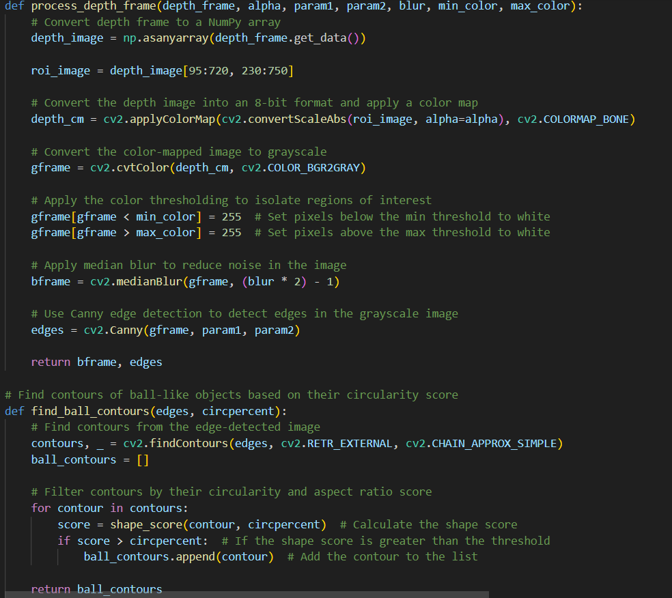
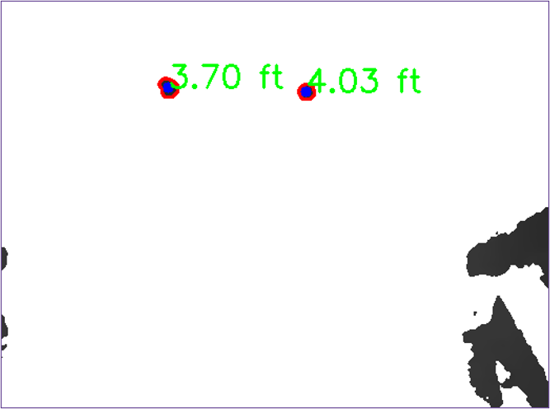
Image Processing Subsystem
Implemented Detection Techniques with Depth Camera
Use of Edges to Determine Shape of Objects Detected
Coordinates Extracted from the Middle of the Detected Object
Processing Speed of Image for Three Frames
Handling False Detections
Final Results

Slide 8
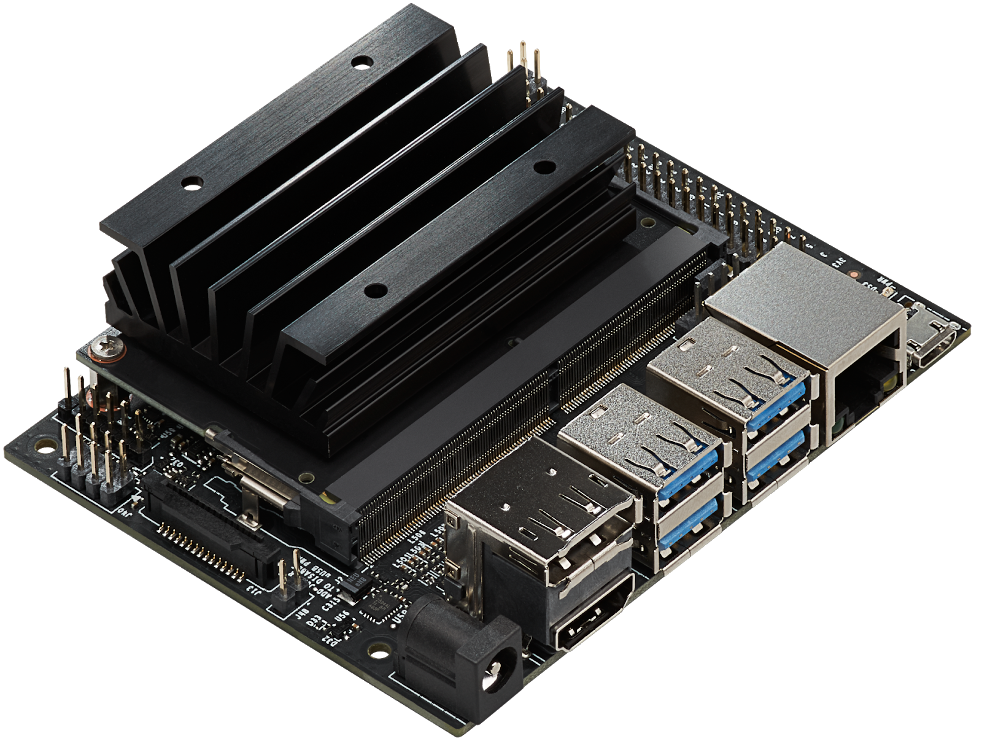
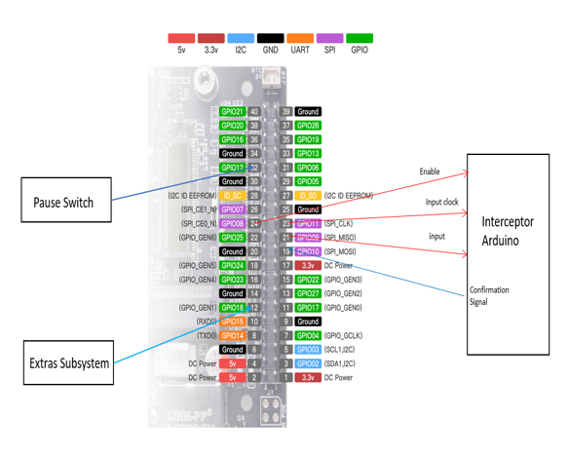
Processor Subsystem
Main code control
Merges entire system to be one congruent system
Communication with Arduino for precise control of the interceptor
Uses lights and buzzer in joint with firing controls
Calculated Interception Point based on received information
Real-time trajectory prediction and aiming
Integrated pause switch for safety compliance.

Slide 9
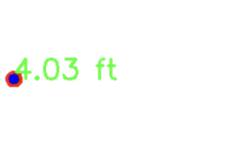
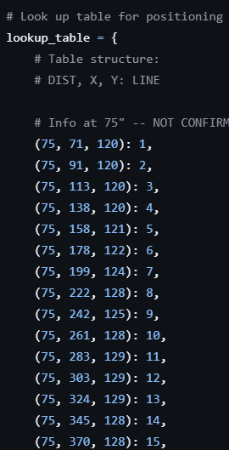

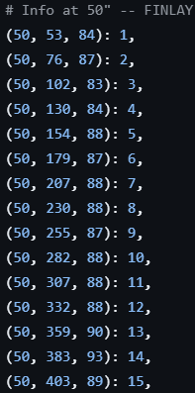
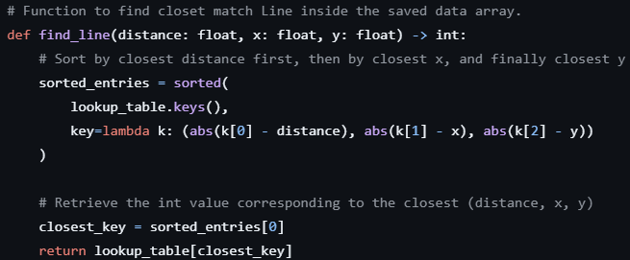
Processor Subsystem - Continued
A lookup table is added to the system to rapidly determine which line the golf ball is on based on image processing data.
Can get line with ANY detection
High Speed, Accuracy, and Efficiency
83 px
48.36 in
286 px
10
2

Slide 10
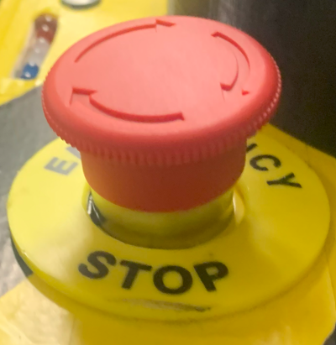
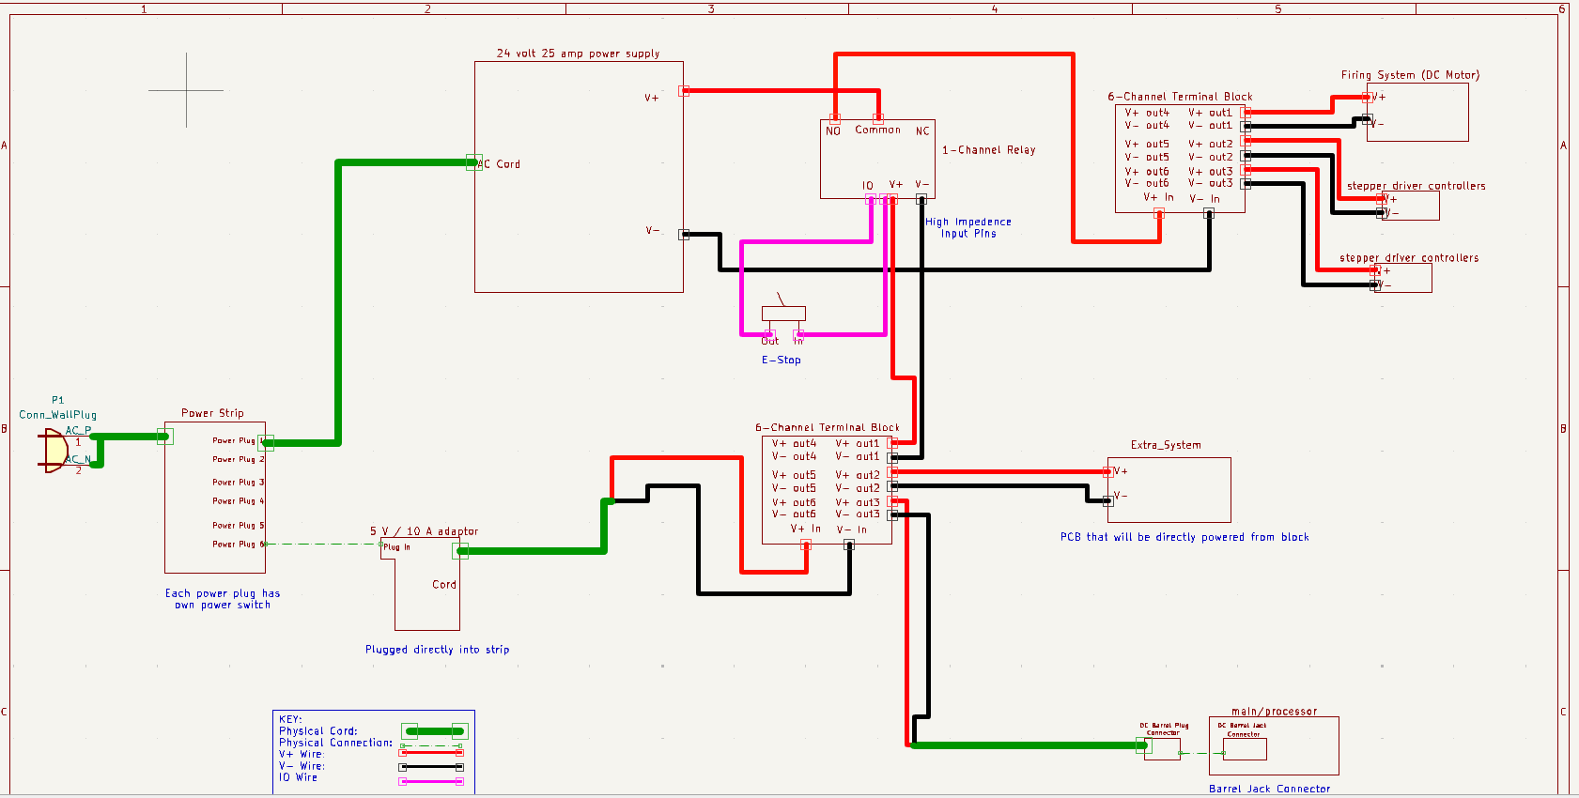
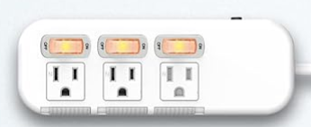
Power Subsystem
Converted wall outlet AC power to DC to then power the entire project.
Split power into two main systems. One powered the processor and extra systems and the other powered only the mechanical system.
Implemented an E-Stop that completely turned off all mechanical system components.
Implemented separate power switches for both supplies.

Slide 11
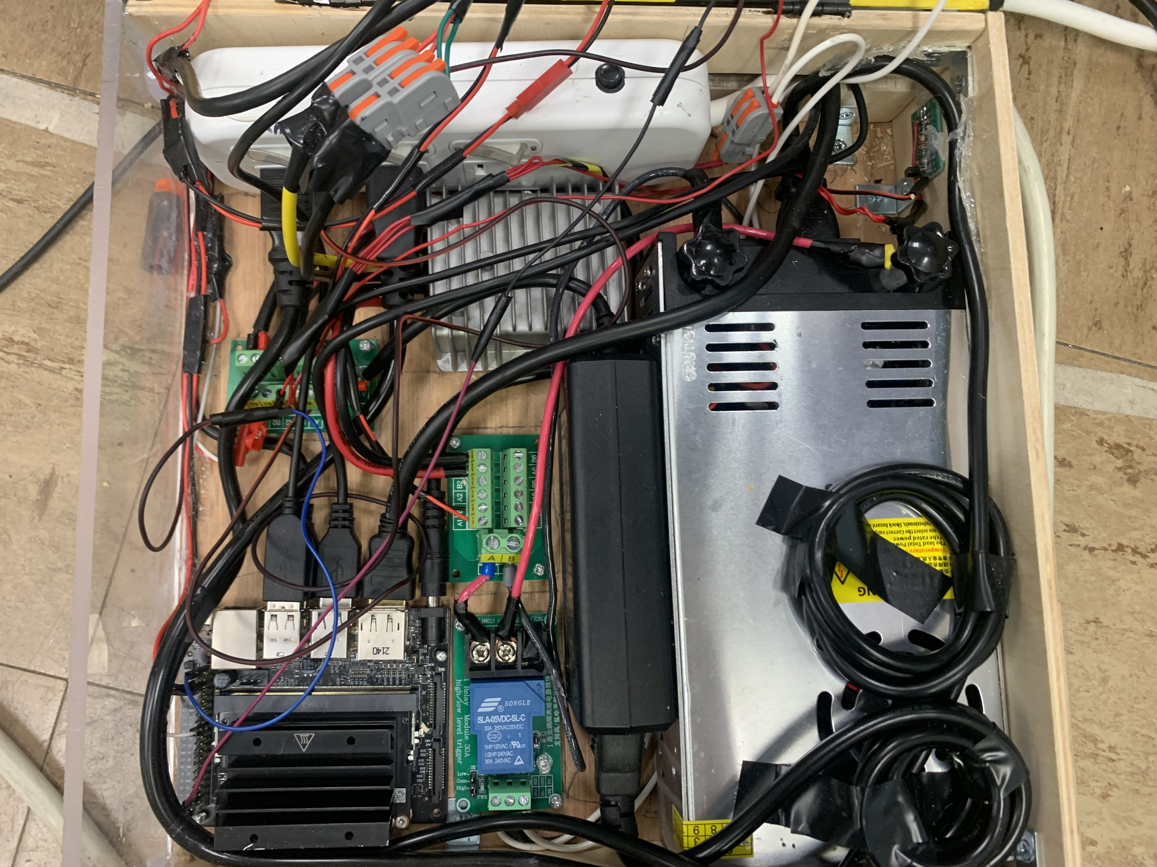
Power Subsystem - Continued
Blue – 24 Volt / 25 Amp Power Supply
Red – 5 Volt / 10 Amp Power Supply
Yellow – 24 to 12 Volt Step-Down Transformer
Green – Power strip and power switch
Purple – Terminal Blocks
Orange – E-Stop controlled relay

Slide 12
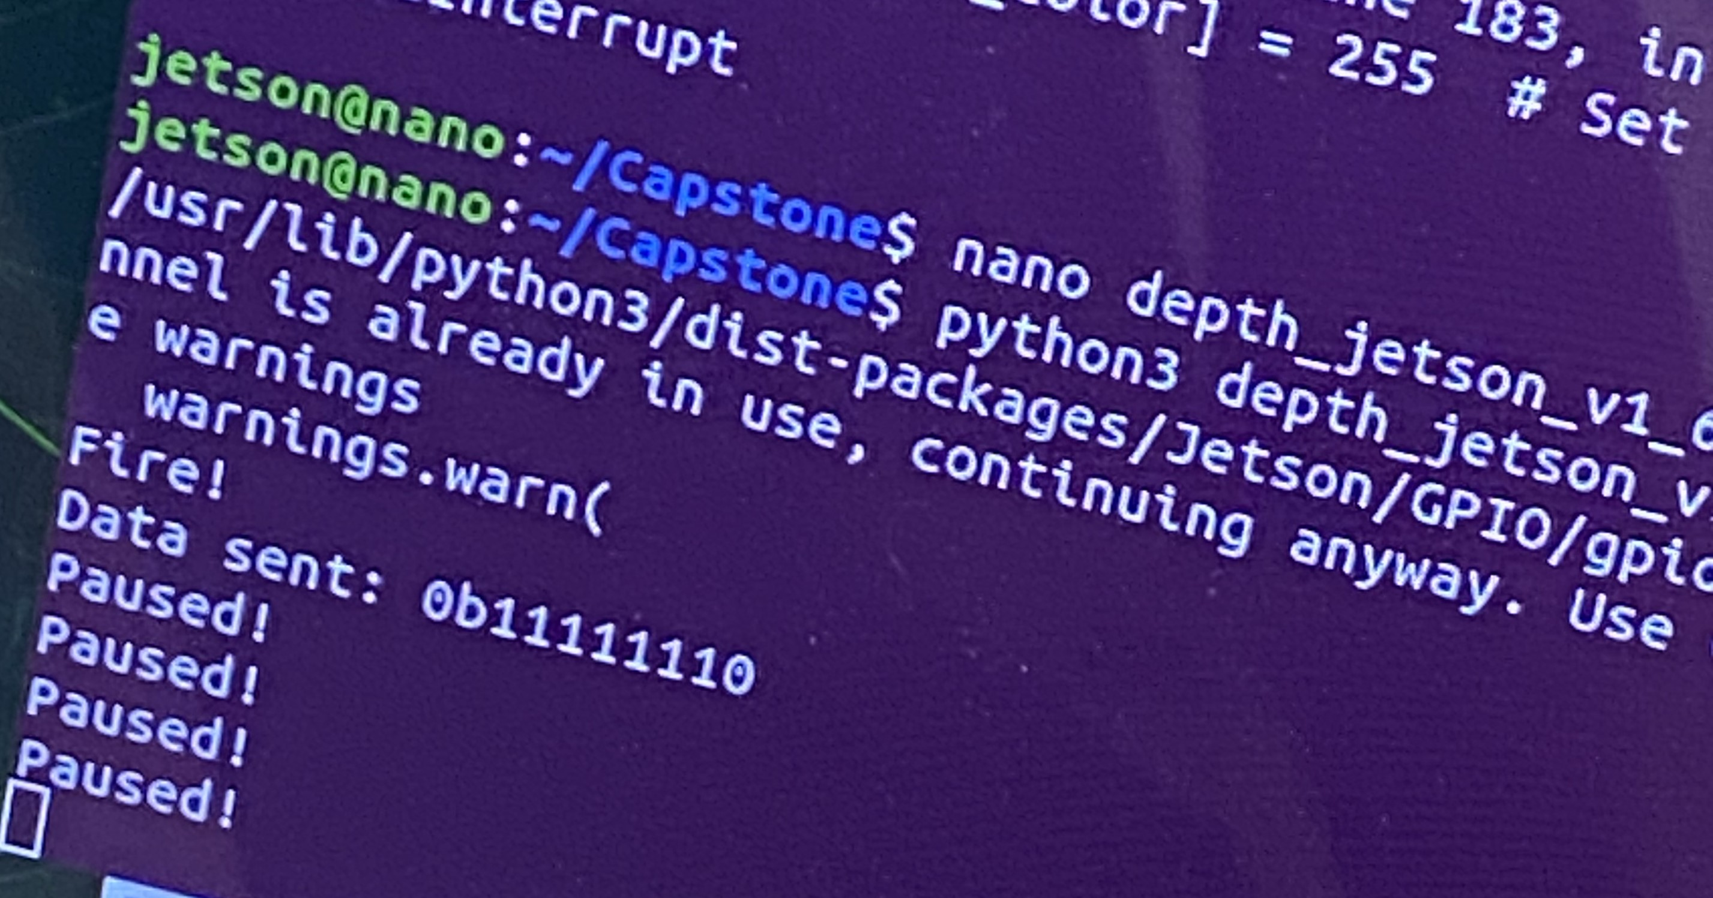
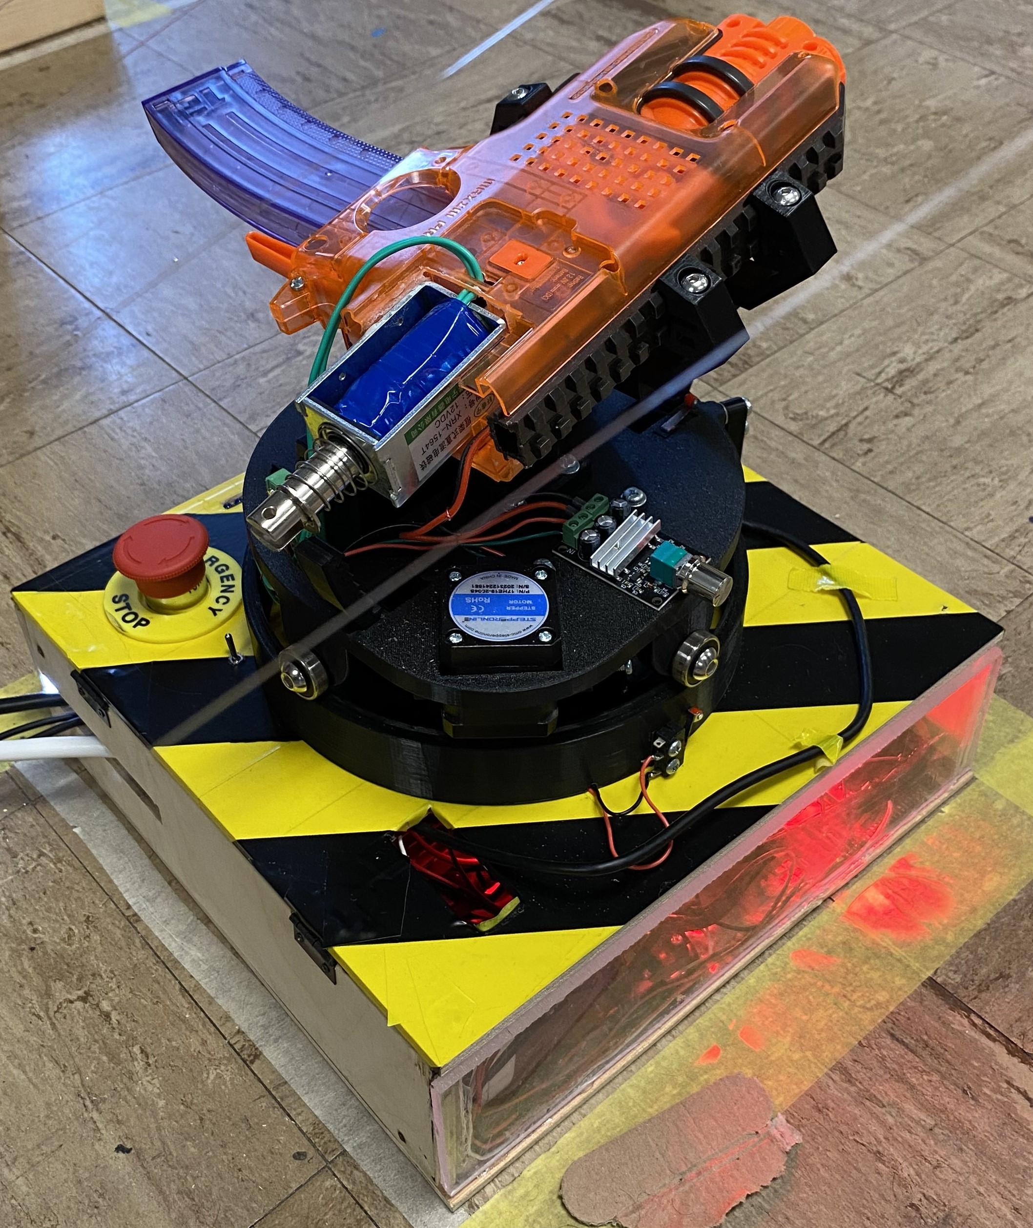
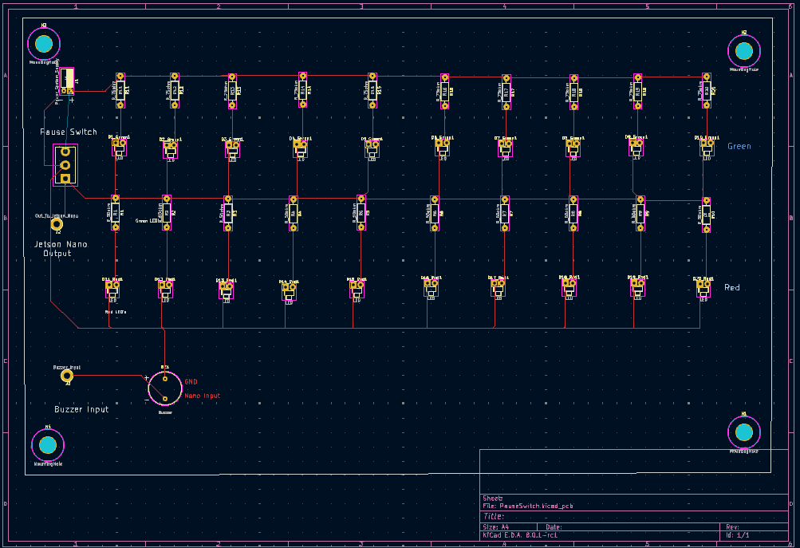
Extra Subsystem
Pause Switch Working with Jetson Nano:
Implemented pause switch, lights, buzzer.
Pause switch required by DEVCOM’s rulebook
Lights and buzzer added to competition points
Lights and pause switch powered by 5V from power system
Jetson Nano high impedance outputs caused redesign to the buzzer circuit
Jetson Nano input to transistor that switches ground

Slide 13
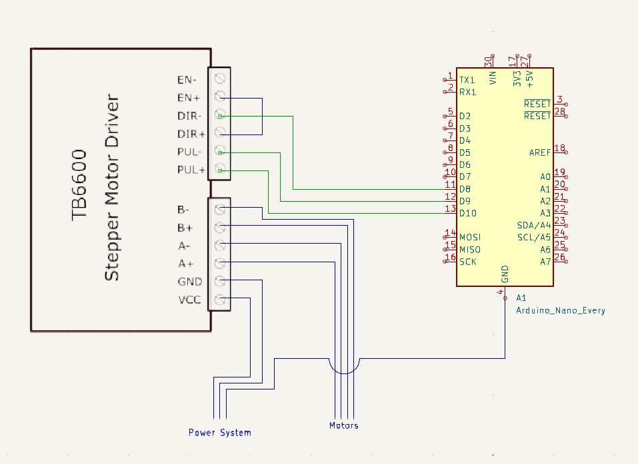
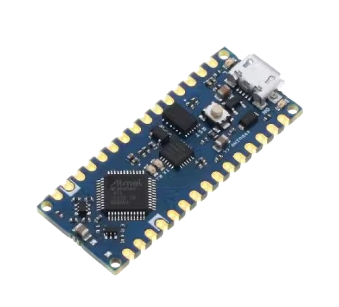
Interceptor Controller Subsystem
Bridge between Mechanical and Electrical Systems
Mechanical
Motor control
Limit Switches
Solenoid/ Firing mechanism
Electrical
Position coordinates
Firing bit

Slide 14
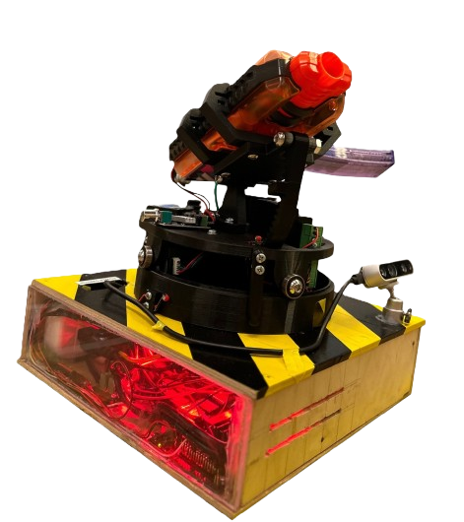
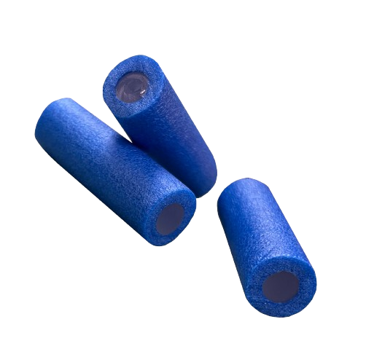
Mechanical
Mechanical Team assigned to help with the project
Made launcher and housing
3D printed parts
Created launcher from Nerf gun base
Revised bullets
Notes:
Savannah

Slide 15
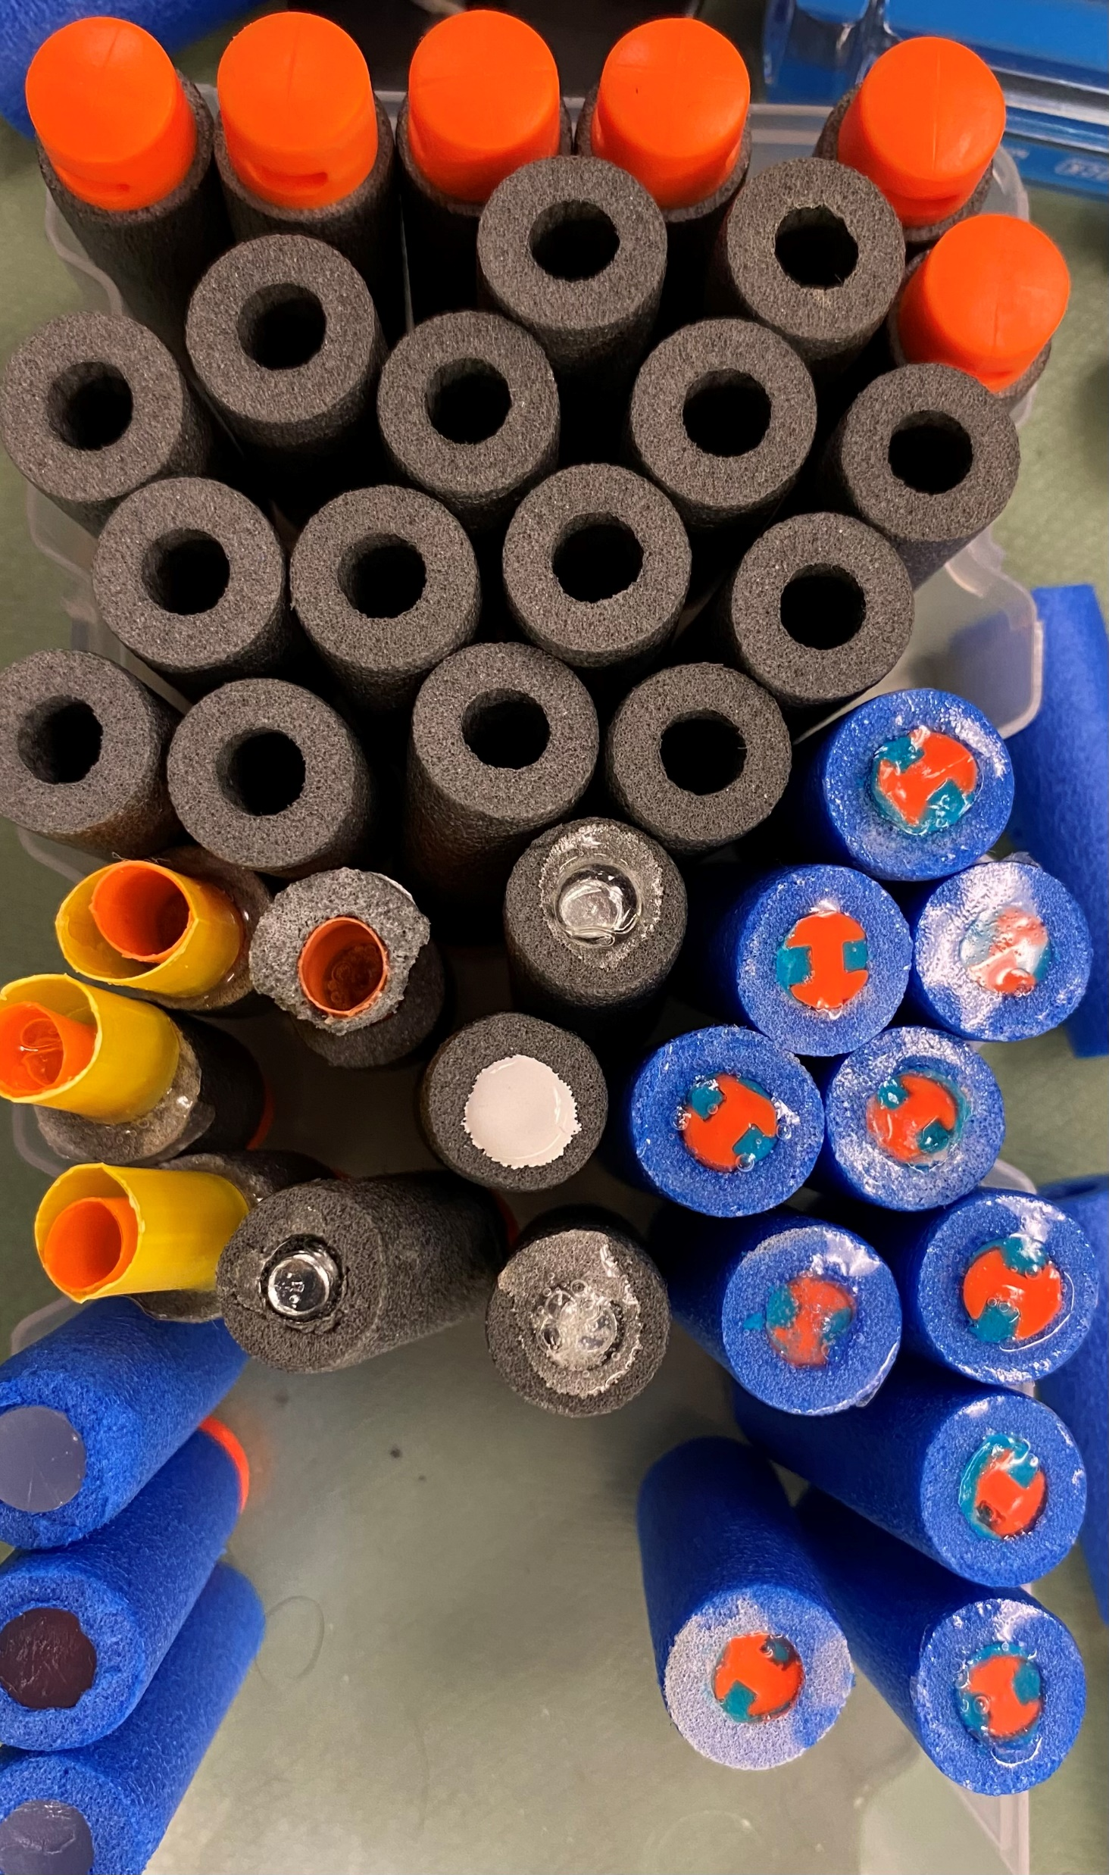
Implementation
Mechanical and Electrical integration went well
We were able to integrate successfully within a couple of weeks
Issues encountered since integration
Building housing
Buzzer and light location
Jamming issues with bullets
Original Nerf Bullets
Play-Dough filled bullets
Bullets with straw end
Caulk filled and nail filled bullets
Final: Hot glue filled bullets
Notes:
JRN

Slide 16
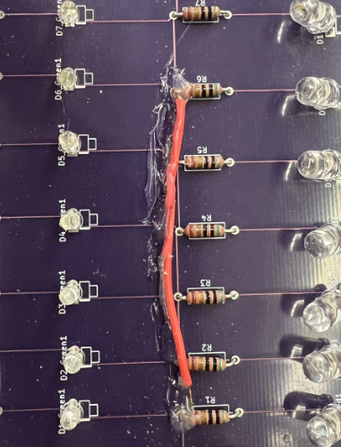

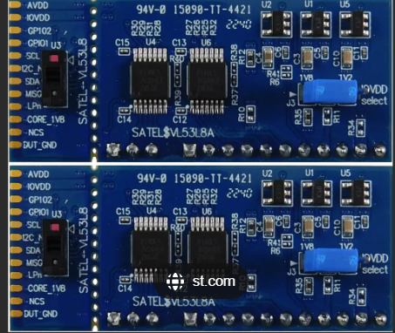
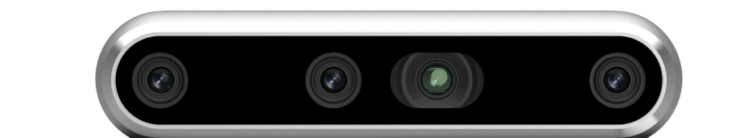
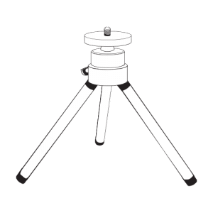
Lessons Learned
Do Not Put Power to Ground
It is Always Good to Have a Back-Up Plan
Things Will Change, Be Flexible
Order Intentionally, Because Things are Expensive
Notes:
Katie

Slide 17
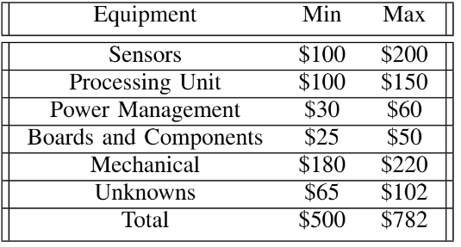
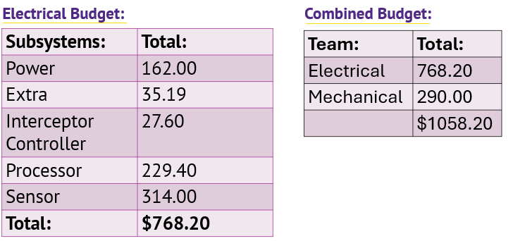
Budget Overview
Proposed Budget:
The team is pleased with the outcome of the project
We were able to complete the project while adhering to DEVCOM’s guidelines
Final Budget vs Proposed Budget
Proposed budget included sensor rather than camera which itself costs $314.00.
Power system and processor were not properly estimated
Final Budget:
Notes:
Savannah

Slide 18

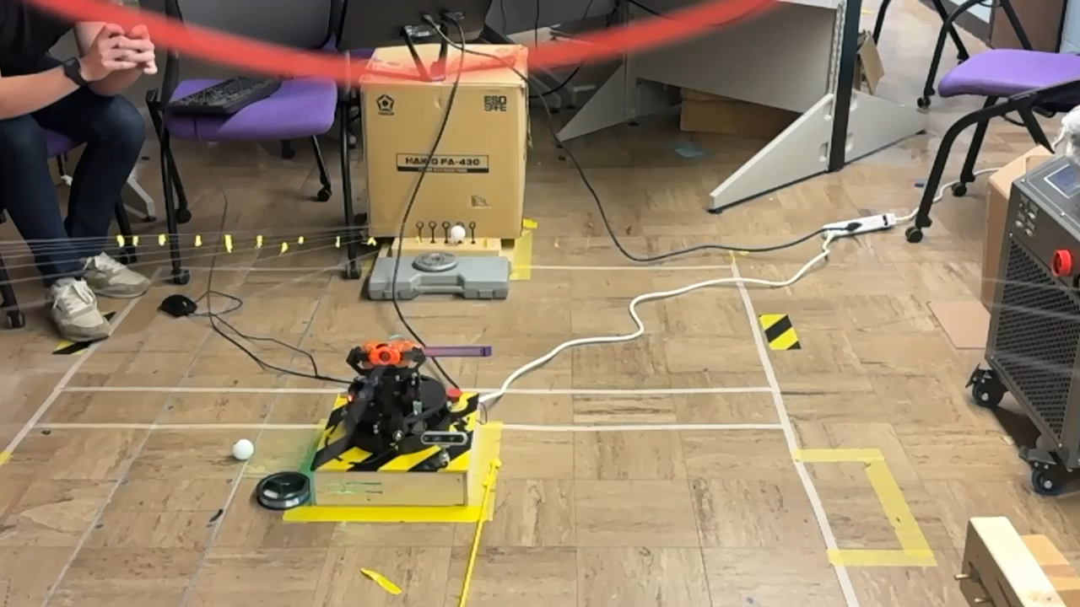

Demonstration

Slide 19
Thank You!
Mechanical Team, Micah Rentschler, Ethan Dixon, Adam Morrow, Cooper Nelson, Sawyer Hall, DEVCOM

